Slide 1

LPE2503| ACADEMIC WRITING(PTG)
SEM 1 24/25
Prerequisite: Passed LPE2403

Slide 2


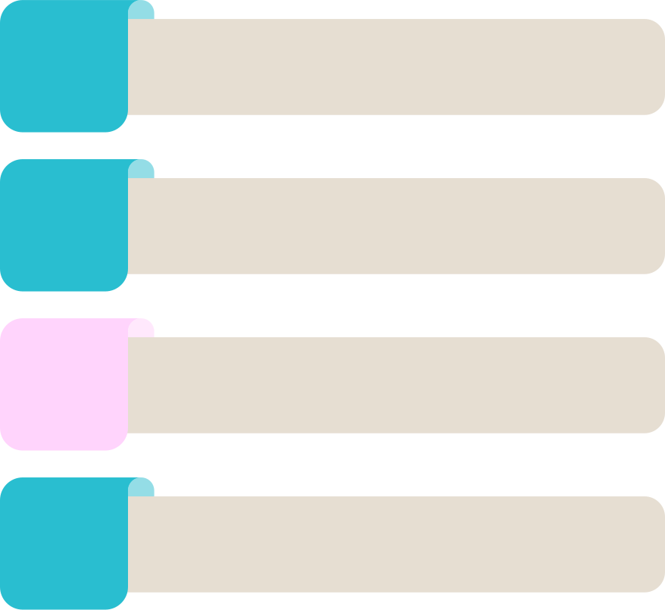

PTG WEEKLY SCHEDULE
1
8
Regular class
Regular class
2
Regular class
9
Regular class
3
10
Regular class
Regular class
4
Regular class
11
PTG
5
12
PTG
PTG
6
PTG
13
Regular class
7
Regular class
14
Regular class

